Slide 1

University of Tampa: Title IX Training
August 19, 2022

Slide 2
Title IX
“No person in the United States shall, on the basis of sex, be excluded from participation in, be denied the benefits of, or be subjected to discrimination under any education program or activity receiving Federal financial assistance.” 20 U.S.C. 1681

Slide 3
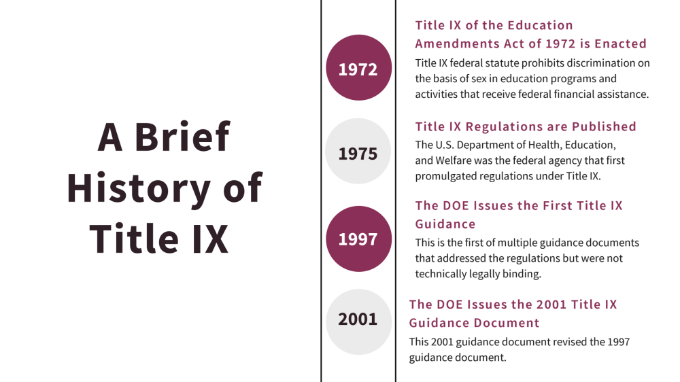

Slide 4
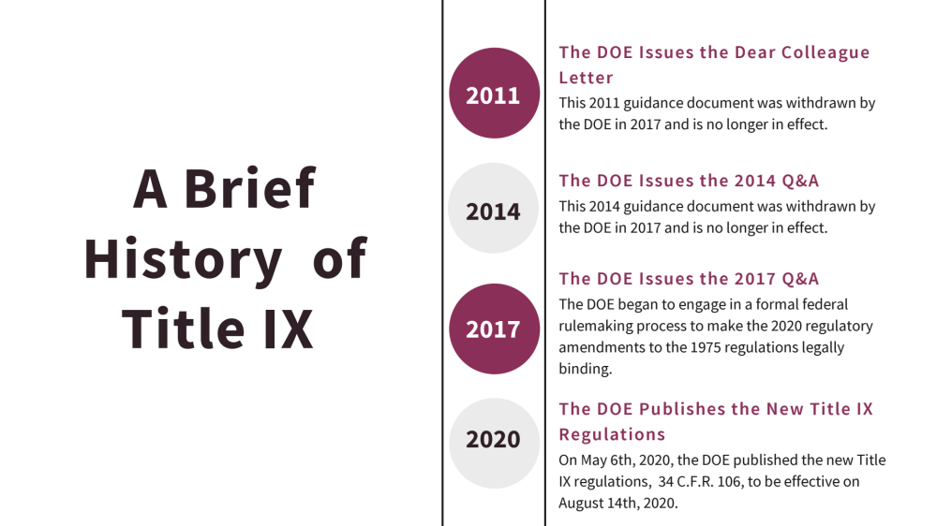

Slide 5
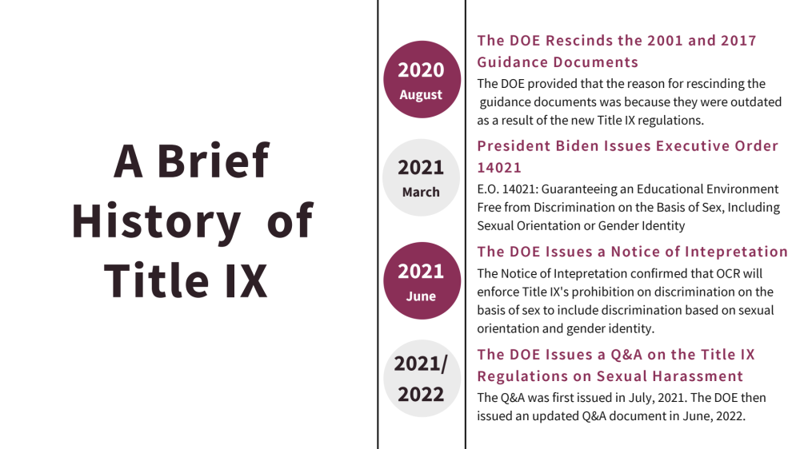

Slide 6
Proposed Regulations
June 23, 2022: The Department of Education released a Notice of Proposed Rulemaking and proposed new Title IX regulations.
The Notice of Proposed Rulemaking Process requires a public comment period. Ends September 12, 2022.
Implementation date of new regulations is unknown.

Slide 7
Your Job
Assist in determining whether University POLICY has been violated.
No legal determinations
No criminal determinations

Slide 8
Receiving and Reviewing a Report

Slide 9
Does this fall under Title IX?
A determination on Title IX jurisdiction is required before the initiation of any Title IX formal resolution options.
Whether a Title IX formal complaint and alleged prohibited conduct is within the scope of the Title IX Policy is based on the following factors:
Whether the alleged prohibited conduct, if proven, meets the definition of prohibited Sexual Harassment within the Title IX Policy.
Whether the alleged conduct occurred in the University’s education program or activity; and
Whether the alleged conduct occurred against a person in the United States.

Slide 10
Does this fall under Title IX?
Whether a Title IX formal complaint and alleged prohibited conduct is within the scope of the Title IX Policy is based on the following factors:
Whether the alleged prohibited conduct, if proven, meets the definition of prohibited Sexual Harassment within the Title IX Policy.
Whether the alleged conduct occurred in the University’s education program or activity; and
Whether the alleged conduct occurred against a person in the United States.

Slide 11
UT Title IX Policy
Dating violence (as defined in the Violence Against Women Act amendments to the Clery Act), means any violence committed by a person: (A) who is or has been in a social relationship of a romantic or intimate nature with the victim; and (B) where the existence of such a relationship shall be determined based on a consideration of the following factors: (i) The length of the relationship; (ii) The type of relationship; and (iii) The frequency of interaction between the persons involved in the relationship.
Dating violence includes, but is not limited to, sexual or physical abuse or the threat of such abuse.
Dating violence does not include acts covered under the definition of domestic violence.

Slide 12
Does this fall under Title IX?
Whether a Title IX formal complaint and alleged prohibited conduct is within the scope of the Title IX Policy is based on the following factors:
Whether the alleged prohibited conduct, if proven, meets the definition of prohibited Sexual Harassment within the Title IX Policy.
Whether the alleged conduct occurred in the University’s education program or activity; and
Whether the alleged conduct occurred against a person in the United States.

Slide 13
UT Title IX Policy
Disclaimer: If at any time during the investigatory process it is determined that the alleged conduct does not meet the definition of sexual harassment or did not occur in a school’s educational program or activity against a person in the United States, the University must dismiss the formal complaint.
However, the University may address the alleged conduct through other appropriate University policies and processes.

Slide 14
Information
Session

Slide 15
UT Title IX Policy– Retaliation
It is the responsibility of all UT employees to report violations of the Title IX Sexual Harassment Policy. In an effort to support an environment for open communication, the University will not tolerate any retaliation or retaliatory behavior against any employee or student who, in good faith, files a grievance, report or concern under the Title IX Policy. For purposes of this Policy, a good faith filing means an honest belief with absence of malice or intent to defraud or seek to disadvantage another.
Retaliatory acts may include intentional acts or threats of action toward another because they reported a violation of policy and/or because of their participation in the Title IX Grievance Procedure. Prohibited retaliatory behavior may include direct and indirect actions.

Slide 16
UT Title IX Policy–Information Session
Title IX Coordinator requests to meet with the individual identified in the Title IX report who is alleged to be the victim of the misconduct described in the report.
It is the Complainant’s choice whether to meet for the information session. A Complainant may still request resources and services and/or file a formal complaint under the Title IX Policy, without an information session.
The Complainant has the right to bring an advisor of choice to the Information Session.

Slide 17
UT Title IX Policy–Information Session
During the Information Session, the Title IX Coordinator will review the report with the Complainant and provide information regarding:
Title IX Jurisdiction
The Title IX Process and Grievance Procedures
Title IX Resolution Options
Any Applicable University Policies
Filing a formal complaint under the Title IX Policy
Supportive Measures
University and Community resources and services

Slide 18
UT Title IX Policy–
Supportive Measures
Supportive measures are non-disciplinary and non-punitive individualized services offered as appropriate, and as reasonably available. Such measures are designed to restore or preserve equal access to UT’s education program or activity without unreasonably burdening the other party, including measures designed to protect the safety of all parties, as well as UT’s educational environment and to deter sexual harassment.

Slide 19
UT Title IX Policy–
Supportive Measures
Supportive Measures may include, but are not limited to:
  Counseling
  Work or class adjustments
  Restrictions on contact
  Extensions of deadlines or other course-related adjustments
  Modifications of work or class schedules
  Campus escort services
  Mutual restrictions on contact between the parties (no contact orders)
  Changes in work or housing locations
  Leaves of absence
  Increased security and monitoring of certain areas of the campus
  Emergency Removal

Slide 20
UT Title IX Policy–
Emergency Removal
The University retains the authority to remove a respondent from UT’s program or activity on an emergency basis, where the University (1) undertakes an individualized safety and risk analysis and (2) determines that an immediate threat to the physical health or safety of any student or other individual arising from the allegations of sexual harassment justifies removal.
If the University determines such removal is necessary, the Respondent will be provided notice and an opportunity to challenge the decision immediately following the removal.

Slide 21
The Formal Complaint

Slide 22
UT Title IX Policy–
Formal Complaint
A document (including an electronic submission) filed by a Complainant with a signature, or other indicia that the Complainant is the person filing the formal complaint, or signed by the Title IX Coordinator, alleging sexual harassment against a respondent about conduct within UT’s education program or activity and requesting UT to investigate the allegation of sexual harassment. At the time of filing the formal complaint, the Complainant must be participating in or attempting to participate in UT’s education program or activity.

Slide 23
UT Title IX Policy–
Dating Violence
Dating violence (as defined in the Violence Against Women Act amendments to the Clery Act), means any violence committed by a person: (A) who is or has been in a social relationship of a romantic or intimate nature with the victim; and (B) where the existence of such a relationship shall be determined based on a consideration of the following factors: (i) The length of the relationship; (ii) The type of relationship; and (iii) The frequency of interaction between the persons involved in the relationship.
Dating violence includes, but is not limited to, sexual or physical abuse or the threat of such abuse.
Dating violence does not include acts covered under the definition of domestic violence.

Slide 24
UT Title IX Policy–
Sexual Assault
Fondling – is the touching of the private body parts of another person for the purpose of sexual gratification, without the consent of the victim, including instances where the victim is incapable of giving consent because of his/her age or because of his/her temporary or permanent mental incapacity.

Slide 25
UT Title IX Policy–
Notice
The Title IX Coordinator and/or designee will send written notice to the Complainant and Respondent indicating receipt of a formal complaint and the commencement of the formal university grievance procedure.

Slide 26
UT Title IX Policy–
Notice
This notice, which is sent to both the Complainant and the Respondent, will include at a minimum:
  Notice of the allegations, the Complainant, and date and location of the incident.
  A copy of the complaint and any other reports or evidence obtained
  Notice of UT’s Title IX Policy and Grievance Procedure
  A statement that the Respondent is presumed not responsible for the alleged conduct and that a determination regarding responsibility is made at the conclusion of the grievance procedure.
  A statement that the burden of gathering evidence and of proving a violation of the Title IX Policy is on the University and not on the Complainant or Respondent.
  The University will not restrict the ability of parties to discuss the allegations or gather and present relevant evidence. The Complainant and Respondent will have an equal opportunity to present fact and expert witnesses and other evidence.

Slide 27
UT Title IX Policy–
Notice
This notice, which is sent to both the Complainant and the Respondent, will include at a minimum:
  A statement that the Complainant and Respondent have the right to an advisor of their choice, including an attorney, who may accompany them during any meetings in relation to the complaint.
  A statement that before the conclusion of the investigation, the parties may inspect and review evidence obtained as part of the investigation that is directly related to the allegations raised in the formal complaint.
  A statement about the University’s retaliation policy.
  A statement providing the Respondent five (5) business days from receipt of the notice to provide a written response to the allegations to the Title IX Coordinator and/or designated individual listed in the notice.
  A statement providing both the Complainant and the Respondent the opportunity to meet with the Title IX Investigator(s) for a pre-Investigative meeting to discuss the Title IX formal resolution process.

Slide 28
Cross Claim

Slide 29
UT Title IX Policy–
Consolidation of Formal Complaints
The University may consolidate formal complaints as to allegations of sexual harassment against more than one Respondent, or by more than one Complainant against one or more Respondents, or by one party against the other party, where the allegations of sexual harassment arise out of the same facts or circumstances.

Slide 30
“Same facts or circumstances”
Preamble to the Title IX Regulations:
The requirement for the same facts and circumstances means that the multiple Complainants’ allegations are so intertwined that their allegations directly relate to all the parties.
Accordingly, if the allegations of sexual harassment arise out of the same facts or circumstances, the parties must receive the same written determination regarding responsibility under § 106.45(b)(7), although the determination of responsibility may be different with respect to each allegation depending on the facts.

Slide 31
Notice of Allegations

Slide 32
UT Title IX Policy–
Notice of Allegations
The Title IX Coordinator and/or designee will send written notice to the Complainant and Respondent indicating receipt of a formal complaint and the commencement of the formal university grievance procedure.

Slide 33
Investigative Interviews

Slide 34
UT Title IX Policy–
Investigative Interviews
The party who filed the initial formal complaint should be interviewed first;
Both parties may have an advisor present;
During this initial interview, the Complainant and the Respondent may provide inculpatory and exculpatory evidence to the investigator(s);
Parties may identify and supply contact information for relevant witnesses to the University investigator(s);
Investigator(s) may, at their discretion, meet with the Complainant and the Respondent for follow-up meetings as they determine necessary.

Slide 35
UT Title IX Policy–
Advisors
During the investigative interview, the Complainant and the Respondent may be accompanied by an advisor of their choice who may be, but is not required to be, an attorney.
The advisor may assist in providing information to the University investigator(s). During the investigation, the University may set restrictions on the role of the advisor, which will apply equally to the Complainant and the Respondent.

Slide 36
Preliminary Investigative Report

Slide 37
UT Title IX Policy–
Preliminary Investigative Report
Prior to the completion of the investigation, and after the University investigator(s) have completed their initial investigation and interviews, the University investigator(s) will submit a preliminary report to the Complainant and the Respondent.
The parties will have an equal opportunity to inspect and review [ALL RELATED] evidence obtained through the investigation, which will be provided to the parties and their advisors, if any, in electronic form or hard copy.
The Complainant and the Respondent will have ten (10) business days to inspect, review, and respond to the preliminary report.

Slide 38
UT Title IX Policy–
Preliminary Investigative Report
The report will include (at a minimum) the following:
A summary of the formal complaint.
A summary of the statements made by the Complainant and the Respondent.
A summary of the statements made by other relevant witnesses.
All expert witness and/or inculpatory and exculpatory evidence provided by the Complainant, Respondent, or any other individuals.
All other information relevant to the investigation as determined by the University investigator.
A summary of relevant evidence provided during the investigation.

Slide 39
Final Investigative Report

Slide 40
UT Title IX Policy–
Final Investigative Report
Upon timely receipt of the Complainant and the Respondent’s responses, which will be considered by the investigator, the University investigator(s) will complete a final investigative report.
This final investigative report will be submitted along with the formal complaint to the Title IX Hearing Board in charge of determining violations of the Title IX policy.
The Complainant and the Respondent will have at least (10) business days to inspect, review, and respond to any information contained within the final investigative report before appearing before a hearing panel.

Slide 41
UT Title IX Policy–
Final Investigative Report
This report will include (at a minimum) the following:
A summary of the formal complaint.
A summary of the statements made by the Complainant and the Respondent.
A summary of the statements made by other relevant witnesses.
All expert witness and/or inculpatory and exculpatory evidence provided by the Complainant, Respondent, or any other individuals.
All other information relevant to the investigation as determined by the University investigator.
A summary of relevant evidence provided during the investigation.
All timely written responses provided by the Complainant and the Respondent.

Slide 42
Hearing

Slide 43
UT Title IX Policy–
Hearing
Individuals permitted to participate in the hearing are the Complainant and the Respondent, a hearing advisor for the Complainant, a hearing advisor for the Respondent, the investigator(s), witnesses, and the hearing panel.
Complainants and Respondents may not waive the right to a hearing.
The University reserves the right to proceed with a hearing in absence of the Complainant and/or the Respondent if all procedural notifications were met as determined by the hearing board chairperson.
Parties may be present at a live hearing or virtually. The hearing is not public.

Slide 44
UT Title IX Policy–
Hearing
It should be noted that the University may still proceed with the hearing in the absence of a party, and may reach a determination of responsibility in their absence, including through any evidence gathered that does not constitute a “statement” by that party. The University may also proceed with the hearing in the absence of a witness.
While the hearing board may review the final investigative report information, when making a determination of responsibility, the hearing board may, but is not required to, rely on statements made by a witness or party within the final investigative report, if the witness and/or party to the case is not present during the hearing.

Slide 45
UT Title IX Policy–
Hearing
Hearing Advisor:
To facilitate aspects of the University Hearing Board, the Complainant and the Respondent will be required to have an advisor present during the Title IX Hearing.
The Complainant and the Respondent may choose to select their own advisor or request the University provide one for the Hearing, which will be provided without charge.
All requests for advisors must be made at least five (5) business days prior to the scheduled hearing. The purpose of the advisor will be to assist their advisee (the Complainant or the Respondent) and to facilitate any questioning and requests for information on behalf of their advisee.

Slide 46
UT Title IX Policy–
Hearing
Hearing Advisor:
The advisor may speak when recognized during the Hearing, however; the advisor may not unduly disrupt the Hearing process. If the advisors’ behavior is determined by the Hearing Board Chairperson to be an impediment to the hearing board process, the Hearing may be adjourned or delayed until a time the party can select a new advisor or that an advisor can be appointed by the University at the request of the party.
Hearing advisors, along with the party they represent, may participate in a pre-hearing management meeting with the Title IX Coordinator and/or designee to address any hearing board rules and for further information on what to expect during the hearing.

Slide 47
UT Title IX Policy–
Hearing
Admission of any person to the hearing shall be at the sole discretion of the hearing board chairperson.
Hearings may not be disrupted by any party. The hearing board chairperson has the authority to remove any individual who is disruptive to the hearing board process and postpone or delay any proceeding until an appropriate level of decorum is restored.
Each hearing will have a sole verbatim record of the proceeding, which will be available for review or inspection by the parties.

Slide 48
UT Title IX Policy–
Hearing
Each hearing board at a minimum will consist of three (3) trained individuals who are free from conflict and/or bias.
Each Hearing Board will have a designated chairperson whose responsibilities include responding to any procedural questions that may arise during a Title IX Hearing. Additionally, the chairperson will be responsible for making determinations regarding the relevancy of questions and information provided during the hearing.

Slide 49
UT Title IX Policy–
Hearing
The hearing board will review all submitted information by all parties. This includes information submitted within the investigative report and presented by investigator(s), parties, and witnesses during the hearing.
The Hearing Board will have at least ten business days to review the Investigator(s) final report prior to the Title IX Hearing.
The hearing board will have the ability to ask relevant questions to all individuals making statements during the hearing.
All procedural questions are resolved by a final decision of the hearing board chairperson.

Slide 50
UT Title IX Policy–
Hearing
Conduct an objective evaluation of all relevant information provided by the Complainant, Respondent, investigator(s), and witnesses during the hearing.
Responsible for reviewing all information contained within the investigative report.
While the hearing board may make credibility determinations, those determinations will not be made based on a person’s status as Complainant, Respondent, or witness.

Slide 51
UT Title IX Policy–
Hearing
Any cross-examination of a witness or party must be done by the advisor for the party, not by the party, and it must be done directly, orally, and in real time.
Before any question is answered on cross-examination, the hearing board chairperson must decide whether the question is relevant.
If the question is excluded, the hearing board chairperson must explain the basis for the decision.

Slide 52
Determination Regarding Responsibility

Slide 53
UT Title IX Policy–
Determination
Regarding Responsibility
After review of the information provided in the investigative report and during the hearing, the Hearing Board will determine (by a preponderance of the evidence) whether the respondent is responsible for violating university policy.

Slide 54
UT Title IX Policy–
Determination
Regarding Responsibility
The preponderance of the evidence standard will apply to the determination of all formal complaints regardless of whether the parties are students, faculty, or employees.
The Hearing board will determine responsibility by a majority vote by using the preponderance of the evidence standard.
This means that the investigation and hearing will determine whether it is more likely than not that a violation of the Title IX Policy occurred.

Slide 55
UT Title IX Policy–
Determination
Regarding Responsibility
After the Hearing Board renders a decision, if the decision is one of no responsibility, then a written determination, consistent with the content and timeline identified below, will be simultaneously provided to the Complainant and the Respondent.
Any decision of responsibility found by a majority vote of the Hearing Board will be referred to the appropriate sanctioning process. The University will initiate its applicable sanctioning process, designed to eliminate the misconduct, prevent its recurrence and remedy its effects, while supporting the University educational mission and Title IX obligations.

Slide 56
Sanctioning

Slide 57
UT Title IX Policy–
Sanctioning
Sanctions and remedies for a finding of responsibility for prohibited Title IX Sexual Harassment may range from a disciplinary reprimand to expulsion or termination of student status or employee appointment. The sanctions also may include supportive measures.
A written determination… will be simultaneously provided to the Complainant and the Respondent.

Slide 58
Written Notice of Outcome

Slide 59
UT Title IX Policy–
Written Notice of Outcome
The written determination will be issued simultaneously to all parties through their University email account, or other reasonable means as necessary. The determination letter will include:
  Identification of the allegations potentially constituting Title IX sexual harassment;
  Description of the procedural steps taken from the receipt of the formal complaint through the determination, including any notifications to the parties, interviews with the parties and witnesses, site visits, methods used to gather other evidence, and hearings held;
  Findings of fact supporting the determination;
  Conclusions regarding which section of the Title IX Policy, if any, the Respondent has or has not violated;
  For each allegation, a statement of, and rationale for, the result, including a determination regarding responsibility, any disciplinary sanction imposed on the Respondent, and an explanation of whether remedies designed to restore or preserve equal access to UT’s education program or activity will be provided by the University to the Complainant;
  The recipient’s procedures and the permitted reasons for the Complainant and Respondent to appeal.

Slide 60
UT Title IX Policy–
Written Notice of Outcome
Timeline of the Determination and Sanction Letter
  If there are no extenuating circumstances, the written determination will be communicated to the Complainant and the Respondent in an official Determination and Sanction Letter sent simultaneously to all parties through their University email account, or other reasonable means of contact, if a third party, within fourteen (14) business days of the conclusion of the hearing.
  The Hearing Board and sanctioning officer must also communicate the determination of responsibility and sanction to the Title IX Coordinator.
  The determination and sanctions will become final upon the written determination from the appeal or, if there was no appeal, the date on which the appeal is no longer timely.

Slide 61
Appeals

Slide 62
UT Title IX Policy–
Appeals
The Complainant and the Respondent may also appeal a determination of responsibility by the Hearing Board.
The submission of an appeal of a determination of responsibility by a hearing board stays any sanctions for the pendency of an appeal. Supportive measures and remote learning opportunities remain available during the pendency of the appeal.
If a party appeals, the University will as soon as practicable, notify the other party in writing of the appeal.

Slide 63
UT Title IX Policy–
Appeals
Appeals are limited to the following:
  Procedural irregularity that affected the outcome of the matter;
  New evidence that was not reasonably available at the time the determination regarding responsibility or dismissal was made, that could affect the outcome of the matter; and
  The Title IX Coordinator, investigator(s), or decision‐maker(s) had a conflict of interest or bias for or against the Complainant or the Respondent generally, or the individual Complainant or Respondent that affected the outcome of the matter.

Slide 64
UT Title IX Policy–
Appeals
Appeals must be submitted in either electronic copy or handwritten copy to the Appellate Officer or designee contained within the Title IX Coordinator Dismissal Letter or Hearing Board Outcome Letter. The appeal must be submitted within five (5) business days of the date the Title IX Coordinator Dismissal Letter or Hearing Board Outcome Letter was submitted to the parties. The appeal must articulate the bases upon which the party is appealing.
Once an appeal is received, the Appellate Officer shall notify the other party of the receipt of the appeal as soon as possible, but no longer than five (5) business days after receipt of the appeal. The other party shall have the opportunity to respond in writing in support of or in opposition to the appeal within two (2) days of receipt of the appeal from the Appellate Officer.

Slide 65
UT Title IX Policy–
Appeals
The appeal will be decided by a trained Appellate Officer or designee who will be free of bias or any conflict of interest.
The Appellate Officer or designee will not be the Title IX Coordinator, Investigator(s), or a member of the Hearing Board.

Slide 66
UT Title IX Policy–
Appeals
The Appellate Officer or designee has the authority to render the following decisions:
  Deny the appeal based on failure to meet established appeal criteria
  Affirm the decision of the Title IX Coordinator and/or designee to dismiss the complaint
  Reinstate the formal complaint and direct the grievance process to continue where and as appropriate
  Affirm the decision of the hearing board
  Accept the appeal and refer the case to a new hearing board for re-adjudication
In all appeal cases, the decision of the Appellate Officer or designee is final. The decision of the Appellate Officer or designee will be in writing, describing the result of the appeal and the rationale for the result. Parties will be notified simultaneously of the decision of the Appellate Officer or designee in writing within ten (10) business days after receipt of the appeal.

